Slide 1
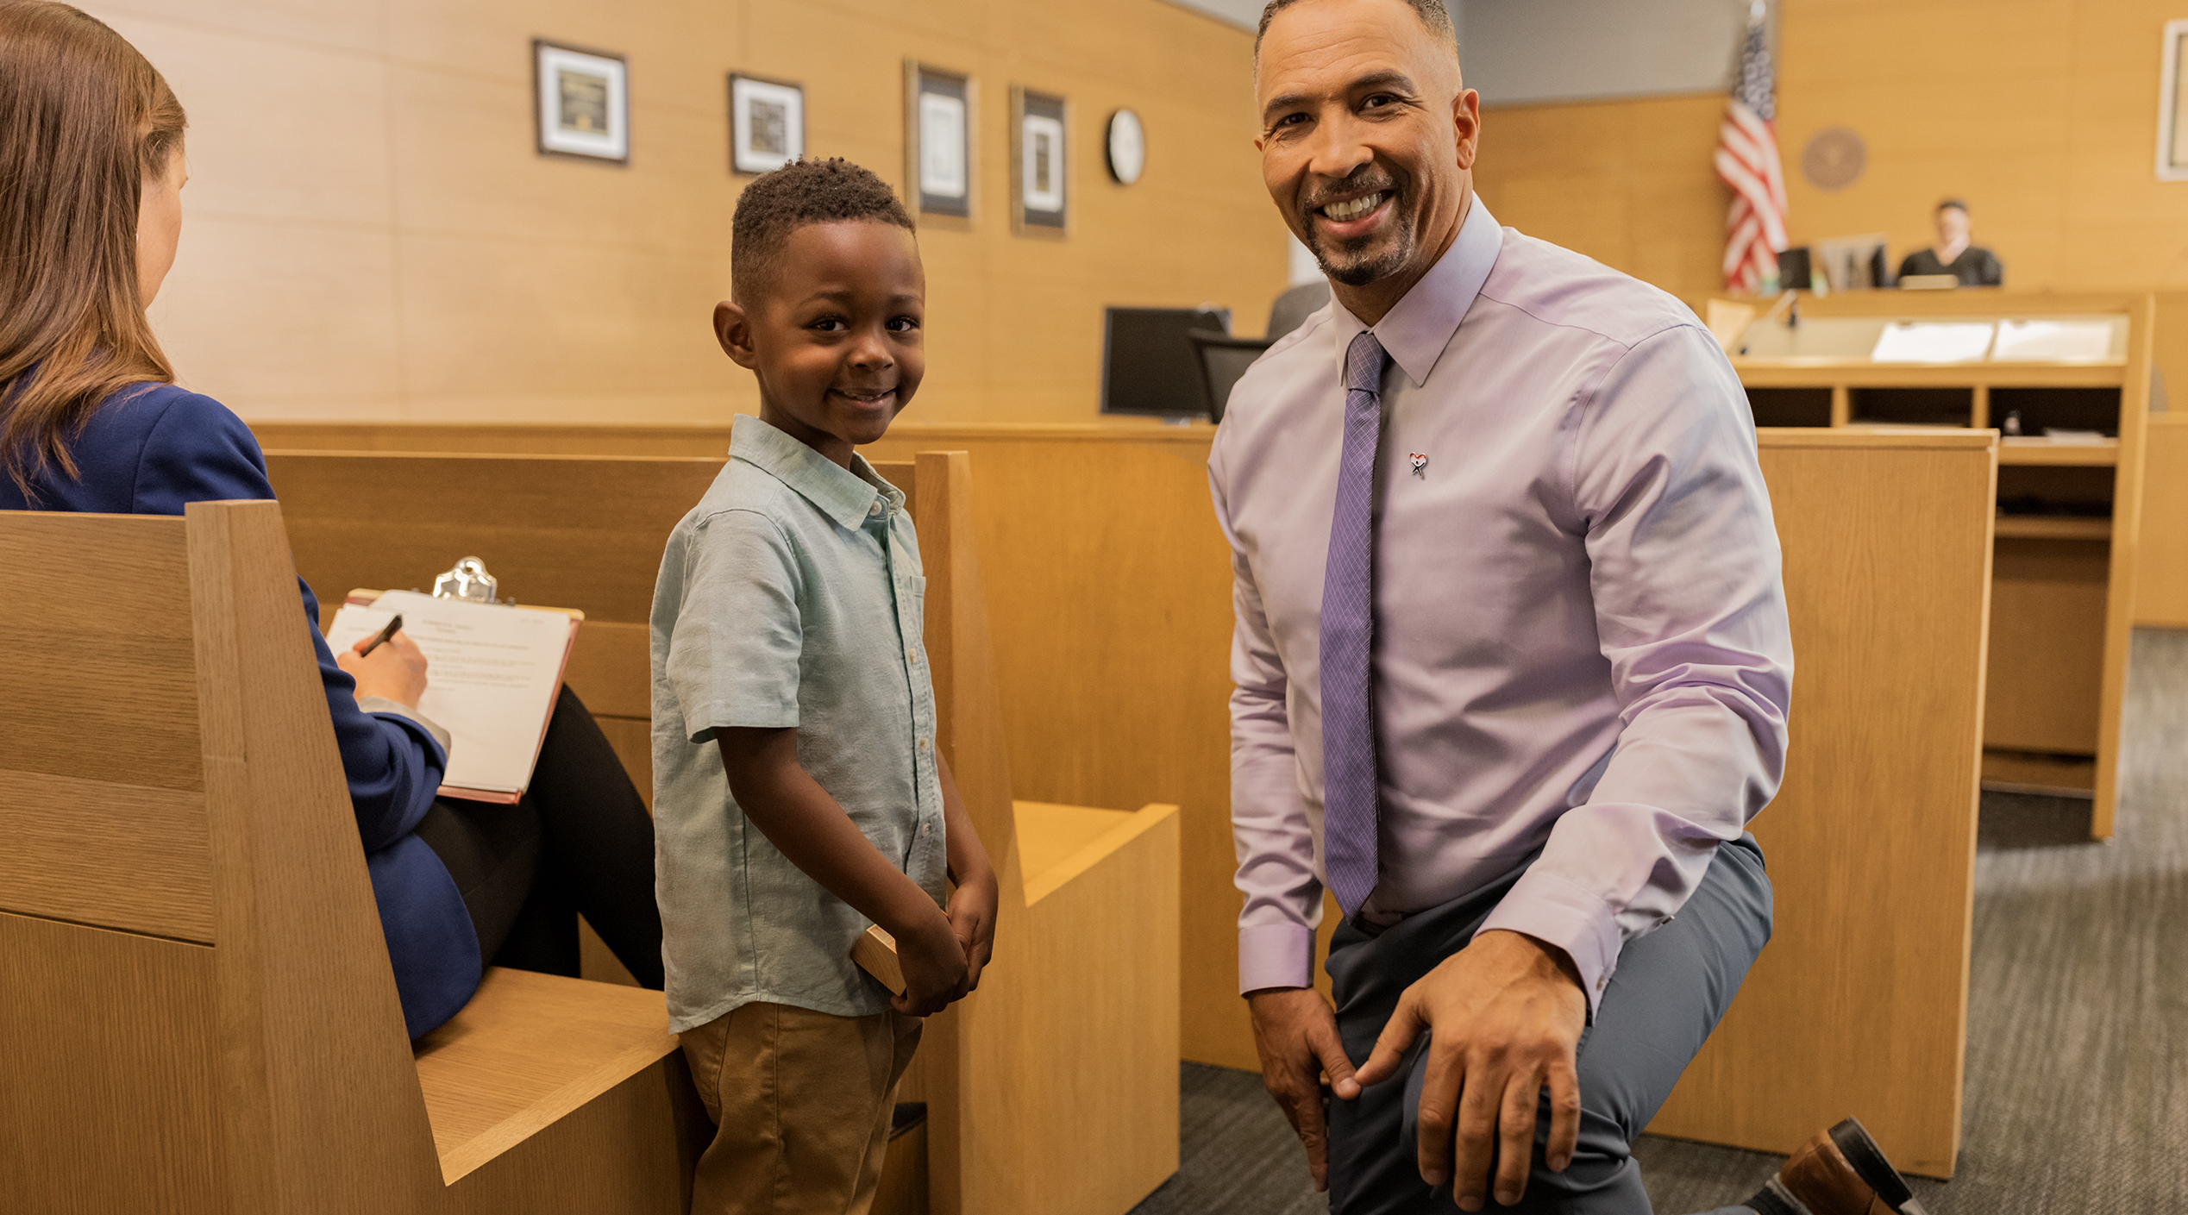

Pitching CASA: Crafting a Clear and Compelling Elevator Speech
Kathleen Kelly, Director of Network Services
Melissa Paris, Director of Training & Impact
Kentucky CASA Network

Slide 2

Agenda
Getting Started: The Power of Persuasive Pitches
Key Components of an Effective Speech
  Statement of Need
  Impact
  Benefits to the Volunteer
  Call to Action
Next Steps: Putting Your Pitch to Work

Slide 3

Special Thanks
Special thanks to the following Kentucky local program staff (and rock star recruiters!) for sharing their insights and ideas for this workshop:
  Beth Ellis – CASA of the Gateway Region
  Liz Hansen – CASA of the Northern Bluegrass Region
  Ben Kleppinger – CASA of Lexington

Slide 4
The Power of Persuasive Pitches

Slide 5

What is an Elevator Speech?
Capture someone’s attention and convey what we do in a limited amount of time
Our elevator pitches should:
  Be concise and compelling
  Make a strong first impression
  Use a conversational tone
  Convey our passion and personal connection to the mission
  Be flexible to fit a specific audience
Notes:
The idea of an elevator speech: If you were at a conference and got on an elevator in your hotel, and someone not connected to the conference gets on – they see your CASA shirt, name badge, etc. and ask – what is CASA? You might have the time it takes to get from the first floor to the 5th floor to explain what CASA is. The CASA volunteer role is a big one, and it can be hard to explain!
It needs to be short and to the point
Make a strong first impression to someone who has never heard of CASA
Although you can plan out your pitch, you want to deliver it in a conversational tone – it’s much more engaging when you keep it conversational versus if you launch into a memorized “speech”
Your passion and possibly your personal connection to this work can come through
We will discuss several ways in which you can pivot and adjust your pitch based on who you’re talking to.

Slide 6

Yes, we are experts on all things CASA….
But how do we talk about CASA to people who have never heard of us and don’t know what we do?
Notes:
Some of you do this all the time and may feel like you have your pitch down, which is great!
Everyone’s pitches could likely use some refining (“I’ve worked for CASA for 6 years and still find myself switching up how I talk about it and finding new ways to convey what we do to the general public)
Give an example of ineffective pitches you’ve used in the past; “We advocate for children in the child welfare system” is not particularly engaging, compelling, and may not make much sense to people outside the system.
If you don’t have a strong pitch you feel great about, today will be a chance to develop it
If you do have one, this will be a chance to get feedback and refine it
Give some info on what the session will look like – they will not have to stand up and deliver a speech, but we’ll take time to workshop some ideas in pairs/at tables

Slide 7

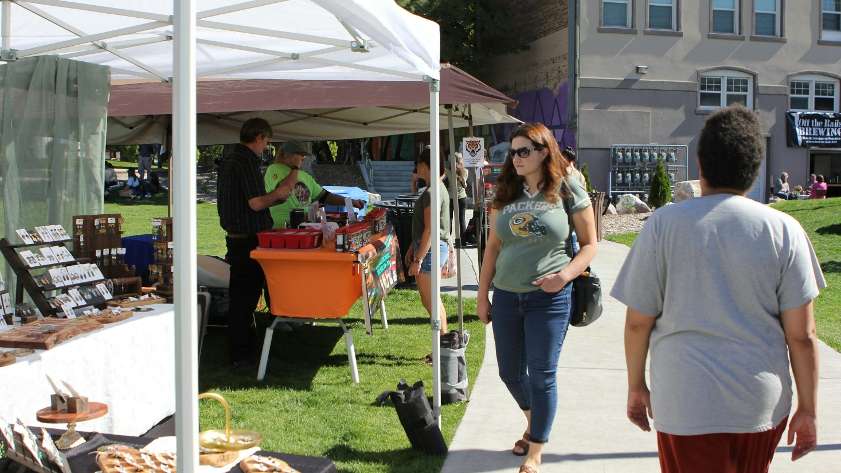



Using Your Pitch
Notes:
Give an overview of different places/venues you can use your pitch
Fairs and tabling events
Fundraisers and other CASA events
Everyday encounters and conversations
Presentations – you might use your elevator pitch to open a longer presentation

Slide 8


Versions of a Pitch
Elevator Speech: 30 seconds to 2 minutes
Extended pitch: Expand your elevator pitch to give a longer presentation
Notes:
Elevator speech is typically – 30-120 seconds (This is what we will focus on today)
For today’s workshop, we will build out a pitch on the longer end of this
Presentation – You can expand on your pitch, adding data, more stories, etc., to make a longer form presentation.

Slide 9
Key Components of an Effective Pitch
Notes:
Let’s get into the key components of a pitch.
Refer to handouts.

Slide 10

Statement of Need: The Hook
Hook listener with a captivating statement of need
  Compelling fact illustrating the problem
  Statistic conveying the urgency of the need
  Descriptive statement offering the perspective of a system-involved child

Slide 11

Statement of Need: The Hook’s Essential Ingredients
Engagement:
  Be yourself
  Be friendly and build rapport
  Catch interest quickly
Clarity:
  Use language that resonates with the general public
  Avoid jargon and system-specific language
Notes:
For this first components, we focus on engaging our listener quickly and using clear language.
We are so accustomed to talking with other CASA folks about this work that we forget how much jargon we use!

Slide 12
Clarity: Language Do’s and Don’ts
System Language You May Want to Avoid:
Terms That May Resonate with General Public:
All acronyms!
Broken system
Child welfare system
Slipping through the cracks
Out of home care
Shed light on…
Placement
Broaden the picture…
Permanency
Voice of the child
Appointed
Speaking up for the child’s needs
The Cabinet, DCBS, GAL
Safe and caring homes
Without more context: Advocate
Caring, stable adult
Notes:
Let’s dive in deeper on avoiding jargon.
All acronyms – including CASA! Later in the pitch, we will identify what CASA is – but our name itself is jargon-y so we aren’t going to introduce it yet, since we are focusing on capturing the listener’s attention.
“Have you ever thought about being a CASA volunteer?” is not a good opening hook statement!
Go through terms in the left column – We use these terms often but this is not language that people use in everyday conversation.
Without more context, even the word “advocate” may not clearly explain what we do.
The terms on the right are more likely to resonate with the general public. Go through these…
The terms on the right are phrases and words that show up in everyday language.

Slide 13

Statement of Need: Developing Your Pitch
Write one sentence that describes the need for CASA volunteers that you think will “hook” someone who doesn’t know much about us.
Notes:
Now we’ll take a few minutes to give you time to develop your own hook statement.
Refer to worksheet.

Slide 14
Statement of Need: Developing Your Pitch
Share your “hook” statement in pairs – offer each other critical feedback.
When offering your partner feedback, consider:
  Did it catch your attention?
  Did it convey a sense of need/urgency?
  Did you hear any jargon?
  What would make it catchier or better illustrate the need?
Notes:
Bring group back together once they’ve written their statements, and give directions for sharing and receiving feedback.
A note on feedback: We are all kind people and sometimes we are hesitant to share critical feedback for fear of hurting someone’s feelings. However, we look at feedback this way: We won’t grow and improve our pitch without the insight from others. We look at feedback this way – I care enough about you and your work to provide thoughtful feedback.
Your challenge, as you listen to your partner’s hook statement, is to provide at least one piece of critical feedback to help them improve their pitch.
Here are some prompts to help you think through feedback you can offer.
After working in pairs, we will solicit 1-2 shares from the audience; briefly get audience feedback on what worked well

Slide 15
Statement of Need: Example “Hook” Statements
The universal hook: Children who have been abused or neglected already have enough to worry about – they shouldn’t have to wonder what happens next and how a judge they’ve never met will be able to make decisions impacting their future.
The heart strings opener: Imagine a child caught up in chaos of the system after experiencing abuse – maybe they’ve been pulled out of the only home they’ve ever known, are living with a foster family they just met, and are feeling alone, scared, and uncertain of what will happen to them next.
For the justice-oriented person: When the system is so stretched and overwhelmed, important things can slip through the cracks – and children who have been abused or neglected cannot afford for the courts to overlook their needs.
For the analytical person: In our county, there are [insert number] children a year who go before the courts because they have been abused or neglected; children need a strong voice advocating for them to make sure their needs are heard.
Notes:
Those were great examples! Now we’d like to share a few more examples that illustrate how you can alter your pitch based on who you’re talking to.

Slide 16

The Impact of CASA Volunteers
How do CASA volunteers address this need?
What makes CASA unique from other players in the system?
Notes:
The next component of the pitch is conveying the impact of CASA volunteers – here is where we describe exactly what we do.

Slide 17
The Impact of CASA Volunteers: Essential Ingredients
Clarity: Describe the CASA role accurately.
  Again, avoid jargon. What language better resonates?
  Don’t inadvertently misrepresent the CASA role!
    Do not: Over-emphasize mentorship
    Do: Include communicating the child’s needs to the courts
Concise detail: What do volunteers actually do?
Authenticity: Use your own style and words to describe the role; a conversational tone will be most likely to engage people.
Notes:
Don’t inadvertently represent the CASA role: Sometimes our stories tend to feature these big stories about ways that CASA volunteers have served as mentors to children. Whlie this can be a component of the work, overemphasizing this part of the work – rather than explaining how we make recommendations to the court – can cause confusion about the role.
Analogy (credit to Ben of CASA of Lexington): We are addressing the child’s needs through CASA advocacy- the “prescription” ordered by the judge is our role as an advocate who shares information with the courts and ensures the child’s needs are heard/addressed. The “side effect” is that the CASA gains a trusted adult to support them along the way. So, in Ben’s case – through the “prescription,” he helped prevent more placement disruptions, but the side effect was shown when Ben was invited to attend the youth’s GED ceremony – Ben was one of the only people in his life who attended.

Slide 18
Describing the Impact – Without Overwhelming
“The court does not want another legal expert – judges need someone who can give a perspective on the everyday, basic needs of a child.”
“We will walk alongside you while you work a case – CASA staff know the system inside and out, so you don’t have to. If you care about kids, you will have everything you need to be a great advocate!”
“CASA volunteers gather information, but we don’t make decisions – we pass along what we learn and leave the decisions to the court and child protection professionals.”
“Most of our volunteers do not have a social services or legal background. It’s their different perspectives that help us be the most useful.”
Notes:
We also want to make sure we don’t overwhelm our listener with our description of the CASA role. Here are some examples of statements we might include to reduce feelings of intimidation.
Tee these up with commentary where appropriate:
If you personally did not come in with a social services/legal background, that personal testimony is useful, too.
The court doesn’t want another legal expert; the court wants another person who wants a parent’s or friend’s perspective on everyday, normal things that the child needs
You don’t make decisions; you gather information and pass it along (sponge analogy)
Your supervisor knows the system inside and out, you as the volunteer do not have to.

Slide 19

The Impact of CASA Volunteers: Developing Your Pitch
Write your description of the CASA role.
  Introduce “Court Appointed Special Advocates, or CASA volunteers”
  Feel free to use CASA at subsequent mentions of the role.
When offering your partner feedback, consider:
  Did you hear any jargon?
  If you knew nothing about CASA, what would you think a volunteer does?
  Was the CASA volunteer role accurately portrayed?
  Would the average person feel overwhelmed or intimidated by this description of the CASA role?
Notes:
Write 2-3 sentences describing the impact of CASA (5 minutes)
Share in Pairs (5 minutes)
Solicit 1-2 examples (2 minutes)

Slide 20
Impact of CASA Volunteers: Examples
A CASA volunteer is an extra set of hands to gather information and shed more light on a child’s situation. Since volunteers have just one case to focus on, we visit the child regularly to get to know them and talk to others involved in the child’s life to better understand their needs. We pass this information on to the courts to help judges decide where a child will be safest and what else the child needs to thrive.
Notes:
Now we’ll share a few more examples…

Slide 21
Impact of CASA Volunteers: Examples
A CASA volunteer is an extra set of hands to gather information and shed more light on a child’s situation. Since volunteers have just one case to focus on, we visit the child regularly to get to know them and talk to others involved in the child’s life to better understand their needs. We pass this information on to the courts to help judges decide where a child will be safest and what else the child needs to thrive.
Through simply building a relationship with the child and getting to know other people involved in the child’s life – which requires no special background or legal knowledge – a CASA volunteer becomes deeply aware of a child’s needs. Judges look to CASA to help them understand what the child needs and what gaps other busy professionals may be overlooking.
Notes:
Child’s wishes?
KK and MP alternate – KK lead off

Slide 22
Impact of CASA Volunteers: Examples
A CASA volunteer is an extra set of hands to gather information and shed more light on a child’s situation. Since volunteers have just one case to focus on, we visit the child regularly to get to know them and talk to others involved in the child’s life to better understand their needs. We pass this information on to the courts to help judges decide where a child will be safest and what else the child needs to thrive.
Through simply building a relationship with the child and getting to know other people involved in the child’s life – which requires no special background or legal knowledge – a CASA volunteer becomes deeply aware of a child’s needs. Judges look to CASA to help them understand what the child needs and what gaps other busy professionals may be overlooking.
Abuse and neglect cases can last a long time. Children may be assigned several different social workers throughout their case and may even move between foster homes or facilities several times. The CASA volunteer is often the one caring, consistent adult throughout their case and can contribute to the stability the children are craving.
Notes:
Child’s wishes?
KK and MP alternate – KK lead off

Slide 23
The Impact of CASA Volunteers: Storytelling
Essential ingredient: Storytelling
  Personal and emotionally engaging stories activate more parts of the brain than sharing facts.
  Storytelling is correlated with increased memory.
  Stories don’t have to feature massive success stories; the small wins are important to highlight, too!
  Consider confidentiality and details that may identify a child or family.
Why Storytelling Works: The Science
Notes:
Storytelling brings to life “the why,” helps us make sense of complex topics
We also want to make sure the stories we use aren’t overwhelming! In fact, the small wins might make the role feel more accessible, less intimidating to the average prospective volunteer; “yeah, I could see myself doing that!”
Confidentiality – especially for small communities; the details can give away a family/child (This is a good reason to “borrow” stories you hear from us, other programs, etc.)

Slide 24

The Impact of CASA Volunteers: Example Stories
A child moved to a new foster home but none of his belongings came with him. No one else had noticed or brought this up until the CASA volunteer visited 5 days later and noticed the child was still wearing the same clothes. The CASA volunteer went to work making sure this child had all the clothing and supplies he needed.
Notes:
Share example stories

Slide 25
The Impact of CASA Volunteers: Example Stories
A volunteer was assigned to a case involving four siblings who were living in an unsanitary environment. The family went to court, but the parents were still not addressing the issues in the home. When the volunteer met with the parents, though, he discovered that they were both illiterate – they did not understand the case plan or resources that had been given to them. The volunteer brought this to the court’s attention and the parents were given additional support and guidance. The children’s parents immediately began addressing the issues noted by the court and the home environment improved drastically. The children, who desperately missed their parents, were safely returned to their home. Their health improved and their teachers noted they were thriving.

Slide 26
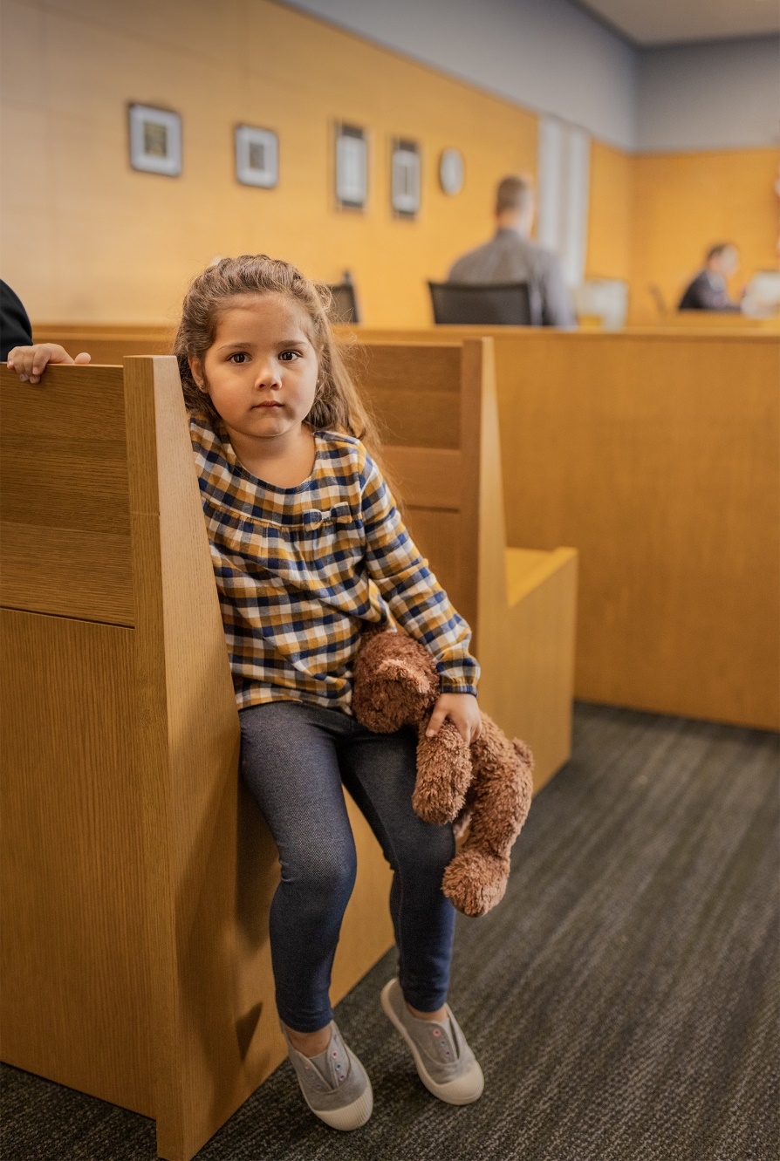
The Impact of CASA Volunteers: Example Stories
A CASA volunteer noticed that a child was hoarding food in their foster home – she was two weeks away from being adopted by this foster family. The CASA volunteer noted their concerns to the County Attorney, and it turns out the foster family was not adequately feeding the child. The child was malnourished and no one realized it. She was moved to a different home and within three months, she were physically and emotionally thriving.
Notes:
Credit: CASA of the Northern Bluegrass

Slide 27

The Impact of CASA Volunteers: Example Stories
One volunteer may have saved a child’s life when she looked back through the child’s medical records to discover she wasn’t receiving medication she needed for a problem with her kidneys. No one else on the case had the time available to do the research, and the child had been moved so many times, the record of her medical need had been lost and forgotten.
Notes:
Credit: CASA of Lexington

Slide 28
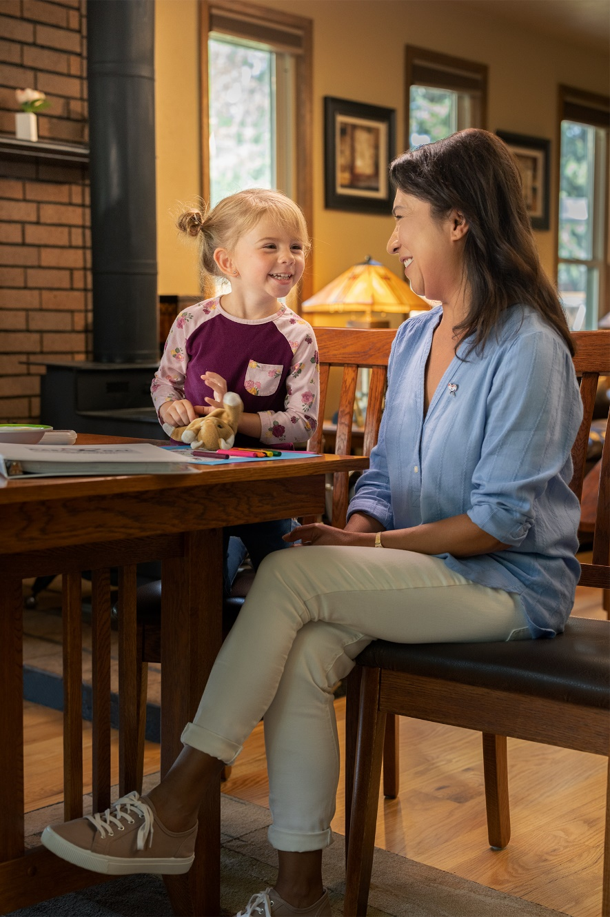
The Impact of CASA Volunteers: Example Stories
A CASA volunteer was assigned to a case of a girl in elementary school who was about to be moved into a remedial reading class. The volunteer got to know the child and learned she always saw letters as “fuzzy” and thought that was just how they were supposed to look. The volunteer recommended an eye exam and glasses, and within two weeks, the girl was moved into her class’s advanced reading group.
Notes:
Credit: CASA of Lexington

Slide 29

The Impact of CASA Volunteers: Developing Your Pitch
Take a moment to reflect upon your experience with CASA. In pairs, discuss an example from a case that helps convey the importance and impact of CASA volunteers.
Notes:
We won’t have time to write out full stories, but we want you to take a few moments to brainstorm what types of stories you might use in your pitch.

Slide 30

The Impact of CASA Volunteers: Developing Your Pitch
Take a moment to reflect upon your experience with CASA. In pairs, discuss an example from a case that helps convey the importance and impact of CASA volunteers.
Jot down the “Cliff’s Notes” version of this story so you don’t forget to add it to your pitch.

Slide 31
Benefits to the Volunteer
Tell the prospective volunteer what they can get out of this experience.
Essential ingredients:
  Honesty
  Positivity
  Passion
Notes:
Now that we’ve figured out how to hook our listener and how to describe the role, we’ve made it through the hardest part! Next we’ll take a minute to explain what the potential volunteer will gain from this experience.
Honesty – aiming to be honest about the role, without scaring folks off (Don’t convey too much too soon, but don’t sugarcoat it!)
Keep it positive, of course
Flexibility – cater this to who you are talking to – what drives/motivates them?

Slide 32
Benefits to the Volunteer: Examples
It’s rewarding: “Being a CASA volunteer is very different from other volunteer roles – where else can you volunteer your time and have such a significant, lasting impact in the life of a child?”
It’s inspiring: “We have CASA volunteers who get updates from the children on their cases long after the case closes, and the accomplishments of these youth are inspiring.”
It’s flexible: “Outside of the scheduled court hearing that we attend together, you can work everything else around your own schedule.”
Align the benefit with your specific audience’s values/interests:
  Pitch to a teacher: “This gives you the opportunity, outside of the classroom, to use your skills to support an individual child.”
  Pitch to a business owner: “Employees who are encouraged and supported to volunteer in the community are more likely to feel connected to their workplace.”
  Pitch to members of a faith community: “This is an opportunity to live your values by serving vulnerable children.”
Notes:
Here are some examples of what you can gain from this particular volunteer opportunity
Flexibility – cater this to who you are talking to
2nd point – highlight that it’s not mentorship but we can still highlights that go beyond the case

Slide 33
Call to Action
Tell the volunteer how they can learn more and get involved.
Essential ingredients:
  Convenience
  Low pressure
  Accessible ask
Notes:
We are going to wrap up our pitch with a clear call to action, letting the listener know how they learn more and any next steps.
Accessible ask - that meets the prospective volunteer where they are

Slide 34

Call to Action: Examples
Provide a range of options:
  Share contact information for follow up
  Attend a CASA 101 to learn more
  Take a handout with info and upcoming training dates
  Share an application, where appropriate.
  Consider joining “Friends of CASA” or the Board of Directors
  If this isn’t the right time for them to volunteer, share our information on social media or with two friends who might be a good fit.
  Make a donation to the CASA program.
Notes:
Facilitation – put it in the words that you would use in an actual pitch
Share contact info: Ask for best way to reach them (email, phone, etc.) to tell them more. Depending on your/program capacity – it may be a coffee date
Invite them to attend upcoming events
Having the next training dates can help put a timeline on when they might get started
Depending upon how the conversation goes, it may be appropriate to share an application
Other avenues – Friends of CASA (non-advocate role), invite them to help share information with others, or support us through a donation.

Slide 35
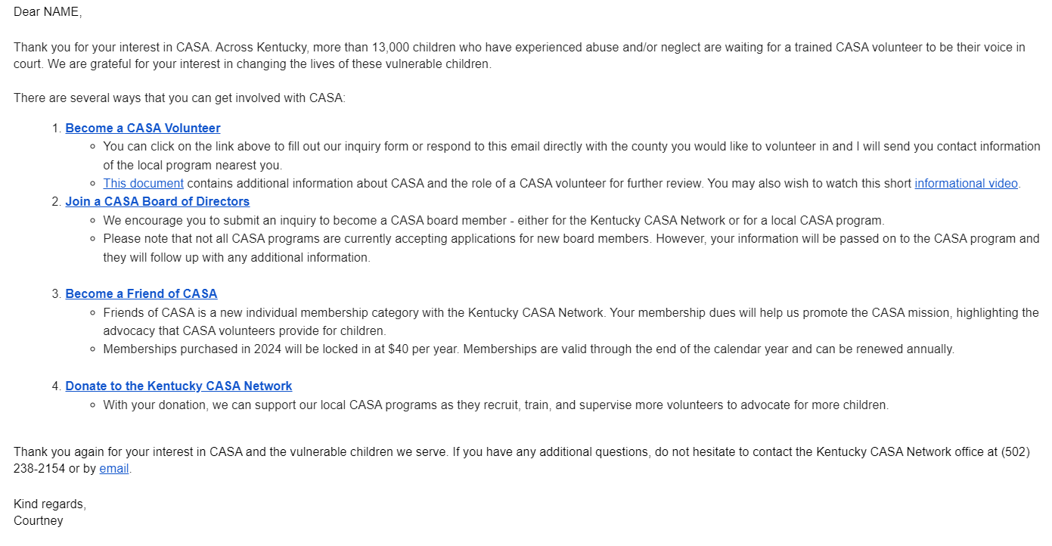
Call to Action: Examples
Notes:
Here is a template we use, in the event that you want to send a follow up email – note the multiple calls to action.
“I cried when I watched that video!” → We hear this a lot!
Note – a single email may not do it!

Slide 36

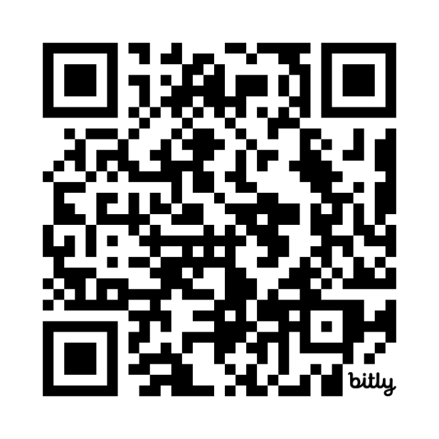
Putting it All Together
Add transitions where needed.
Review and revise.
Practice and get feedback!
Notes:
IF TIME -- One of us or audience member give a full pitch
Continue to hone your messaging
Try it out – friends, families, etc.
Practice at team meetings, trainings, other internal gatherings
Talk to new volunteers to see how they describe the role
What did volunteers not know/understand when they first learned about CASA that they wish they would’ve known?

Slide 37
Putting Your Pitch to Work

Slide 38
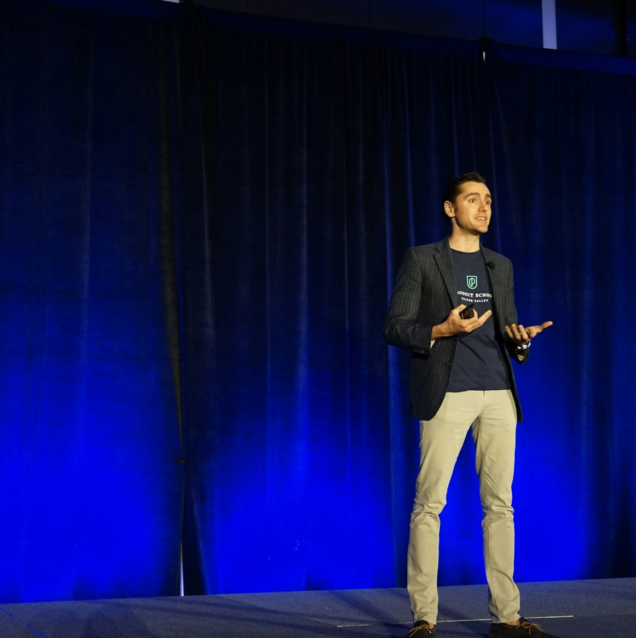
Tips for Using Your Pitch
Keep it casual and conversational.
Tweak it for the setting and audience.
Be flexible and adjust for time – sometimes it will be shorter, sometimes it will be longer.
Be prepared to address frequently asked questions!
Notes:
Shouldn’t sound rehearsed or robotic.
Tweak for setting – depending where you are, you may open with some small talk (“Have you been enjoying the fair today? Great! Can I tell you a little bit about what Court Appointed Special Advocates do?”

Slide 39
After the Pitch
Be persistent but not pushy!
  It’s a volunteer role – life happens and other things will sidetrack people’s attention. We have to work for it!
  Continue to engage them through email newsletters, invites to events, etc.
  Email interested volunteers every time you have a new pre-service training scheduled.
  Follow ups are often appreciated!
  “I know life is busy and if right now is not the time for you, we get it! Just let us know if something changes down the road and you want to be removed from our list.”
Notes:
Share examples from Liz
Keep following up, people appreciate it
Set reminders on your calendar
“I’m so grateful you keep checking in with me! I really want to do this! Thank you for not giving up on me!”
Training dates – ask if they want to continue to be sent future dates; options for online trainings

Slide 40

Resources
Story Bank Template
  Programs: Create a story bank for all staff, volunteers and board members to use. (Include small wins, big impact stories)
Frequently Asked Questions (FAQs)

Slide 41
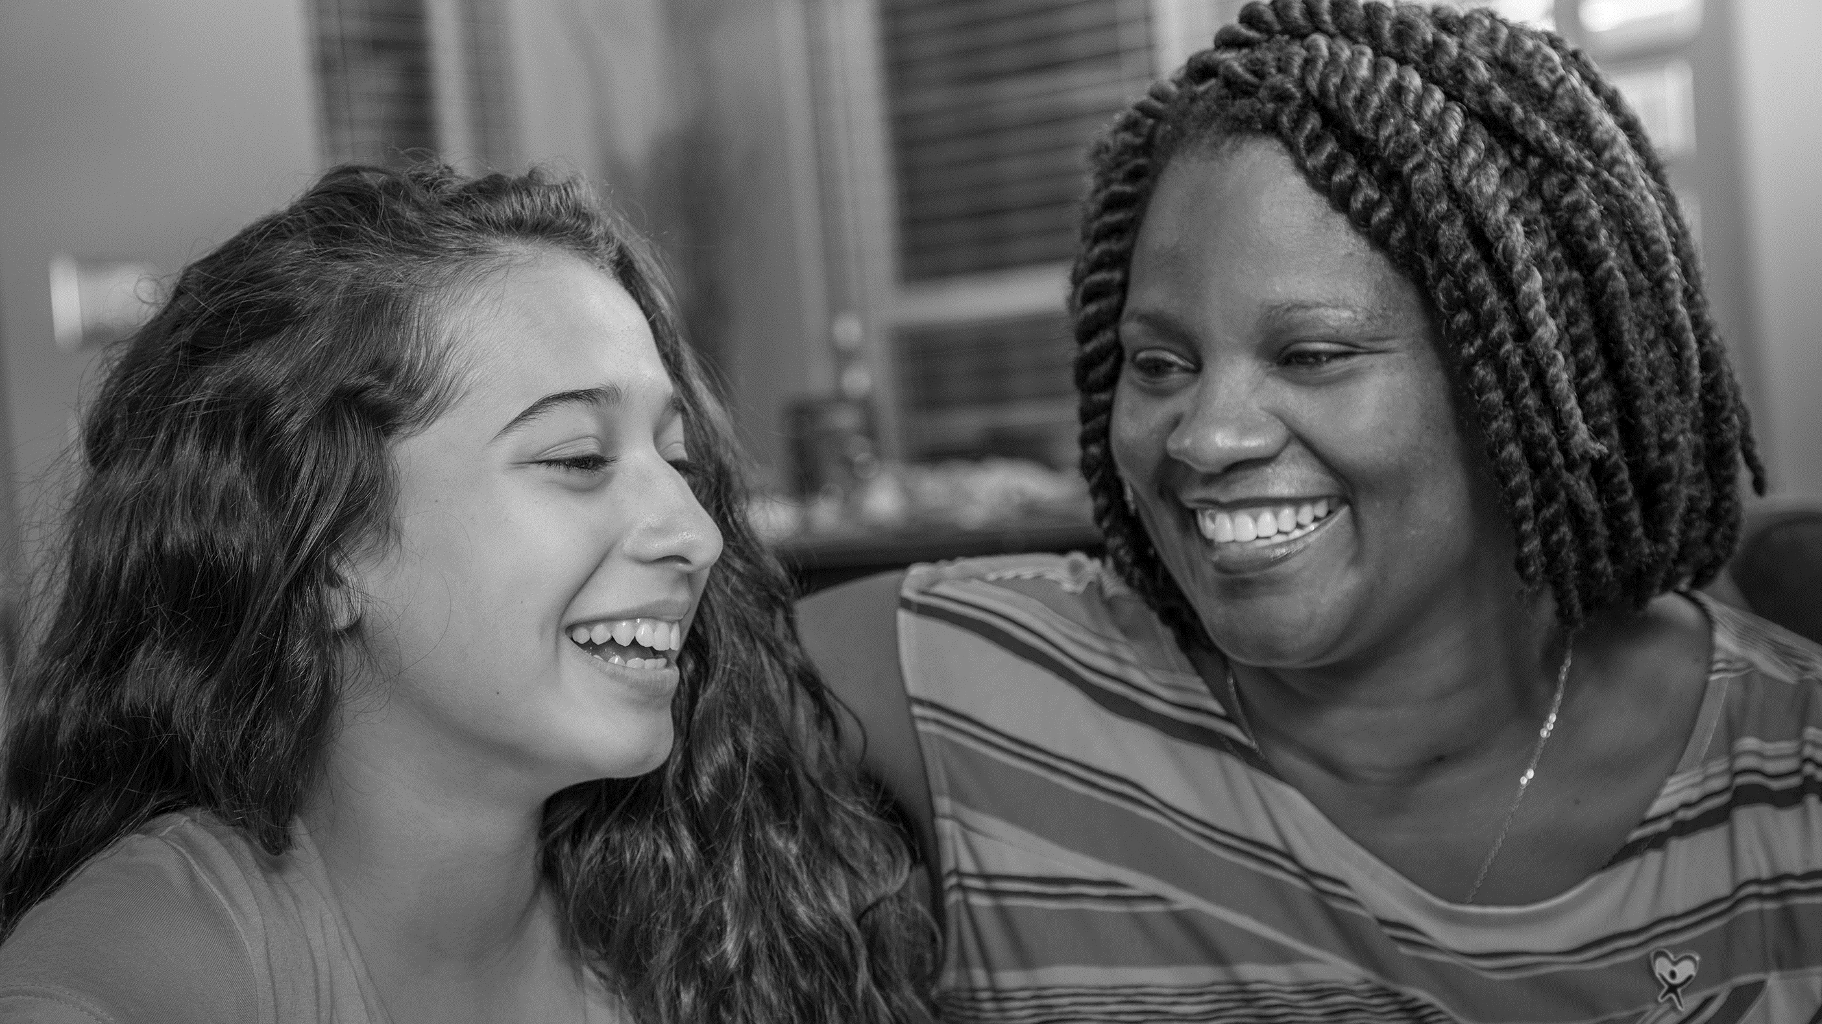
Questions?

Slide 42
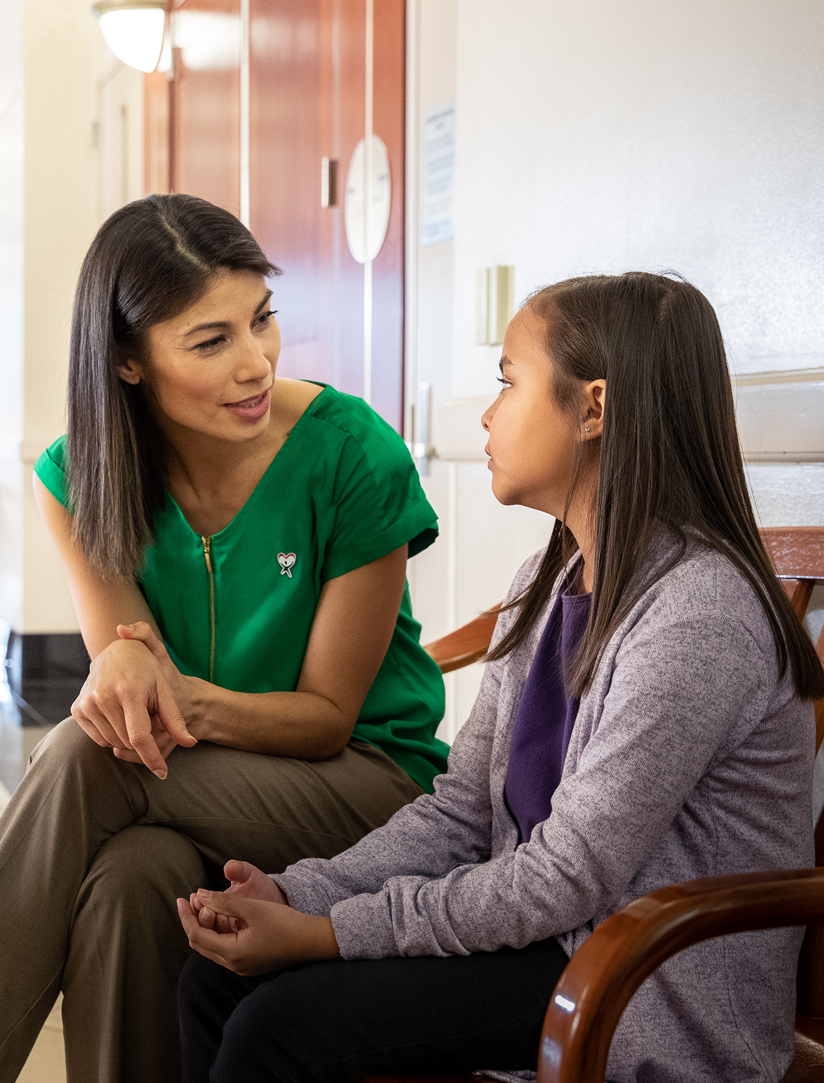

Contact Us
Kathleen Kelly
KKelly@kentuckycasanetwork.org
Melissa Paris
MParis@kentuckycasanetwork.org
www.kentuckycasanetwork.org

Slide 43


Thank You!

